Slide 1


Slide 2

Presented by Missouri Valley Master Gardeners

Slide 3
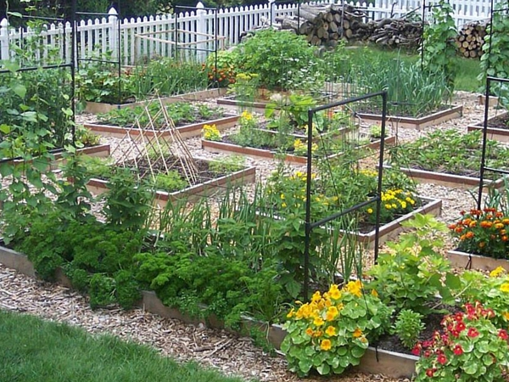
How to Read Your Plants
How to plant the most in the smallest space

Slide 4
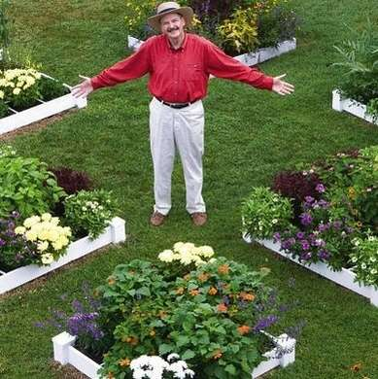
Square Foot Gardening
Developed by Mel Bartholomew, an engineer not a gardener
Wrote the first book in 1981
Too much wasted space and resources
Too much work

Slide 5
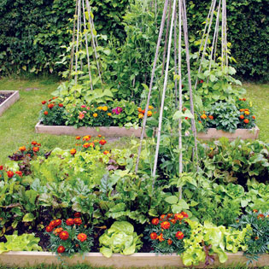
Location
Close to house, easy to tend because you see it all the time
Plenty of sun, at least 6-8 hours of direct sun
  Can use shade of plants for crops that need less than full sun all day
Good drainage, water does not puddle in the spot
Away from tree roots

Slide 6
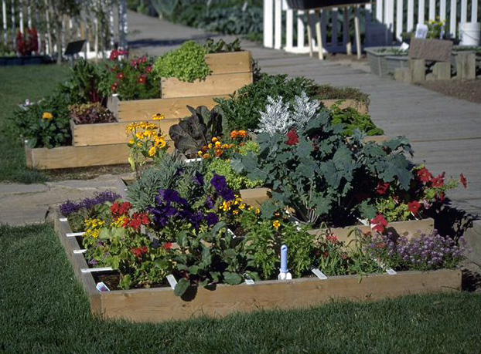
Direction
Plant UP not down
  No need to amend existing soil
  Create great planting area on top of the soil that is already in the location
  Depth of 6 inches
  Easy access 3 feet between boxes or beds

Slide 7
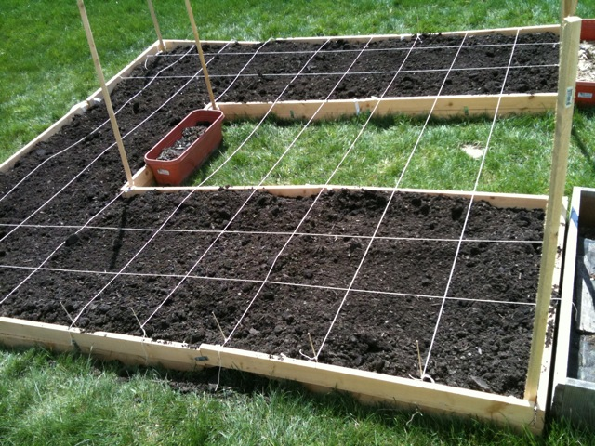
Size of Beds
You need to be able to reach across them, usually 4 foot, children’s size 3 foot
You can use any configuration as long as you make them no more than 4 foot and have at least 3 foot aisles

Slide 8
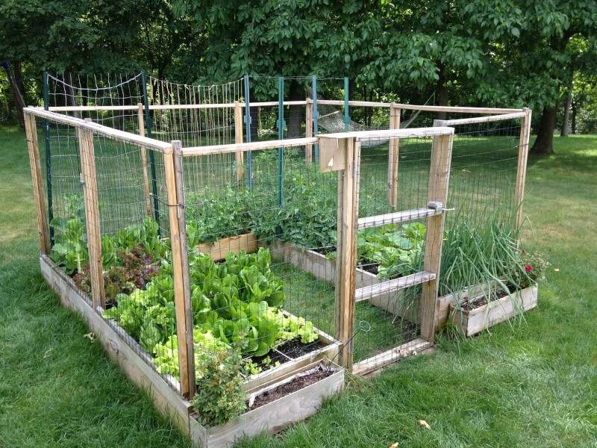
Boxes?
Looks tidy
Holds soil
Easy to add protection

Slide 9
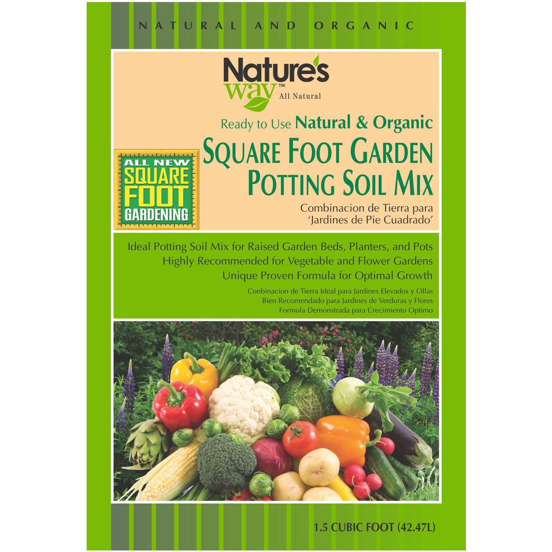
Soil mixture
4X4 bed will need 8 cubic feet of mix
Compost 1/3
Peat moss 1/3
  Compressed bales
  A non renewable natural resource
  Wear gloves and mask
Vermiculite 1/3
  Course
  Look for larger 4 cubic foot bag
  Can substitute Vermiculite (does not hold moisture as well)
  Wear gloves and mask
No Fertilizer
No Digging
2 large bags (3.5 cu ft) vermiculite, $18.00 each
1 large bale (3.8 cu ft compressed, expands to be more) peat moss, $9.00
8 bags (1 cu ft) compost, $2.00 each (average price)
6 extra bags (1 cu ft) compost, $2.00 each (average price)
TOTAL COST (three 4’x4′ boxes): $73.00

Slide 10
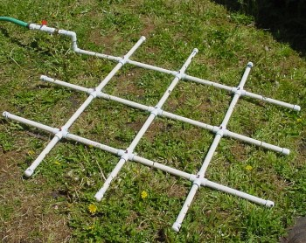
Grids
Square foot
Wood Lath can be bought in 4 foot lengths
PVC piping can be adapted to a watering system
Blinds such as Venetian
Strings

Slide 11
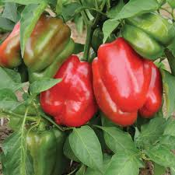
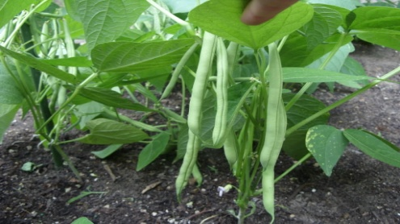
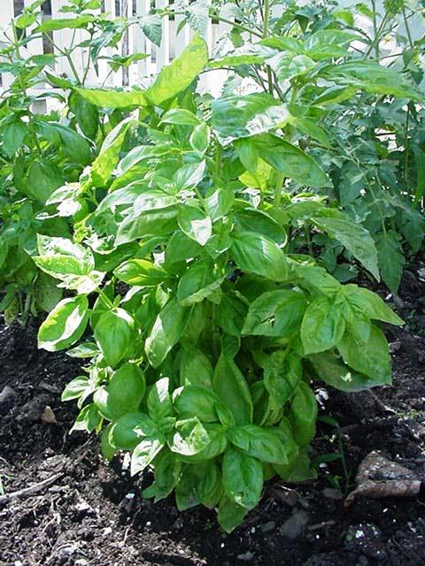
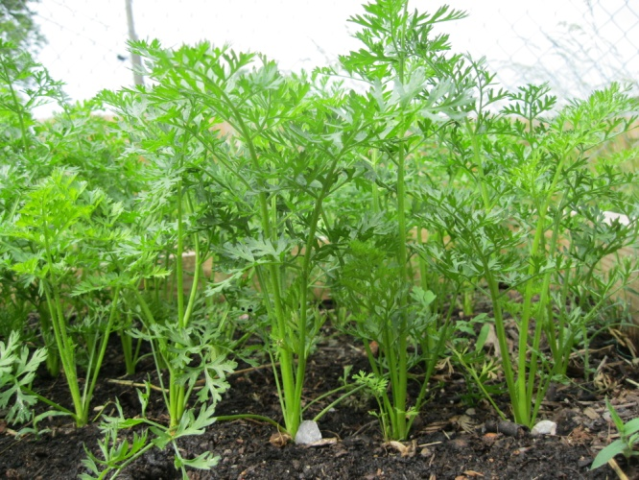
Planting Small, Medium, Large and Extra Large
Extra Large-One per Square
  Cabbage
  Peppers
  Broccoli
  Cauliflower
Large-Four per Square
  Parsley
  Basil
  Lettuce
  Kale
Medium-Nine per Square
  Bush Beans
  Beets
  Turnips
Small-Sixteen per Square
  Leaf Lettuce
  Carrots
  Onions
  Radish

Slide 12
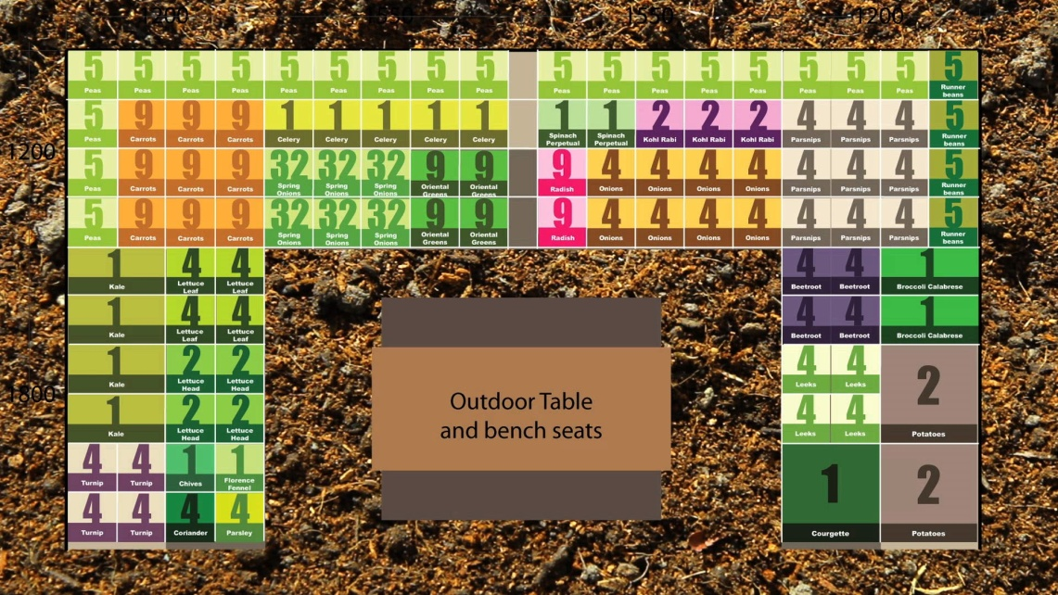
Planting

Slide 13
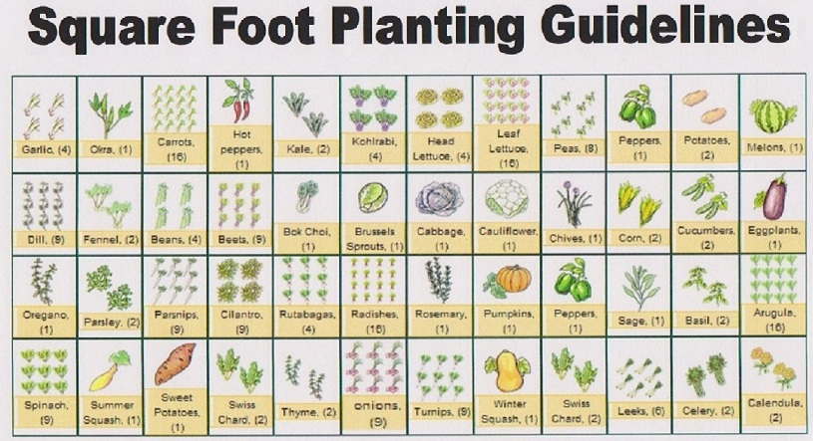
Plantings

Slide 14
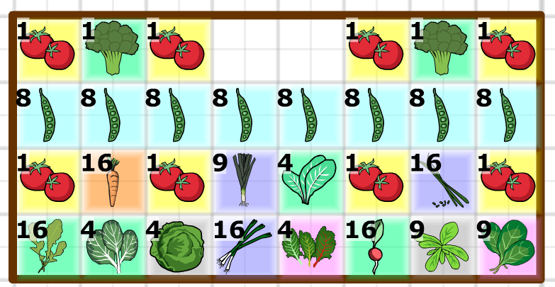
Planting

Slide 15
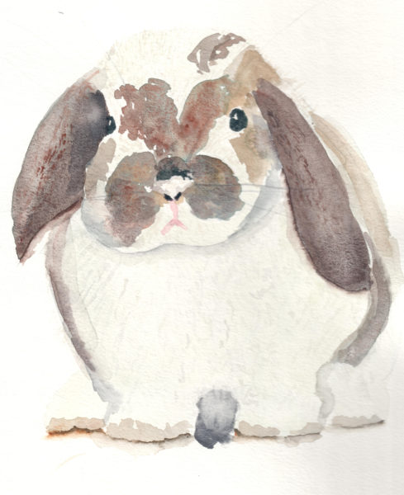

Slide 16
Pruning
cutting away dead or overgrown branches or stems, especially to increase fruitfulness and growth.

Slide 17
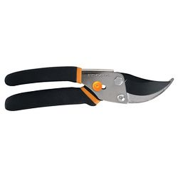
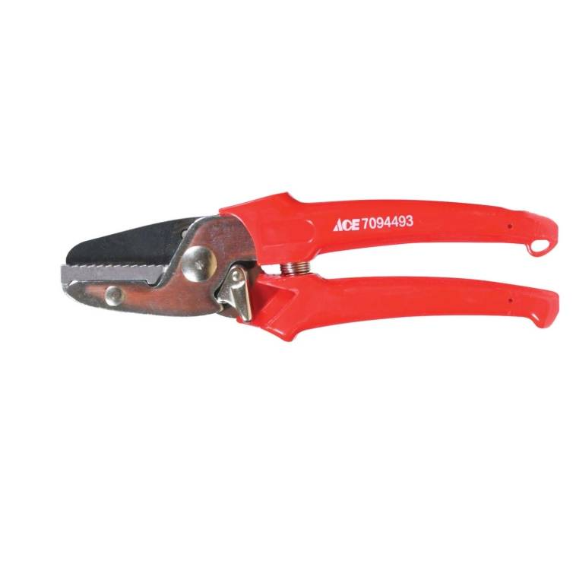
Pruning Tools
Pruning Shears
Bypass (scissor-like blades) for growing stems
Anvil (straight blades) for dry branches and stems

Slide 18
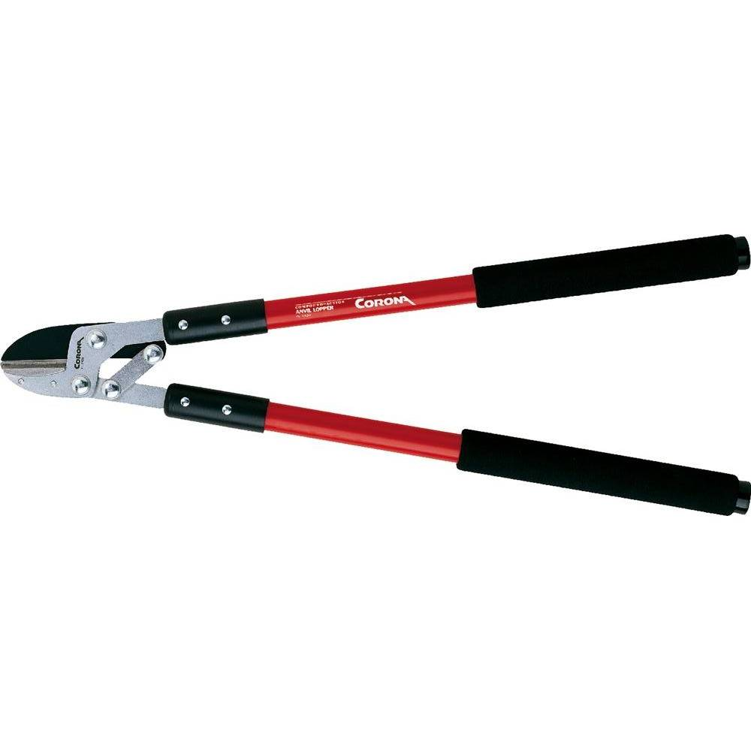
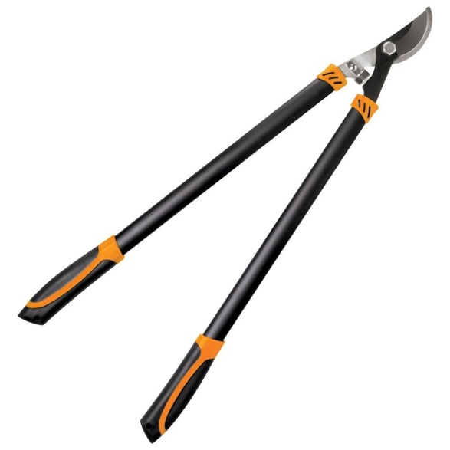
Pruning tools
Loppers for pruning branches (trees and woody vines) up to 2 ½” thick
Anvil: for dead material or preparatory cuts
Bypass: for cuts that affect the health of the plant. Keep razor sharp.

Slide 19
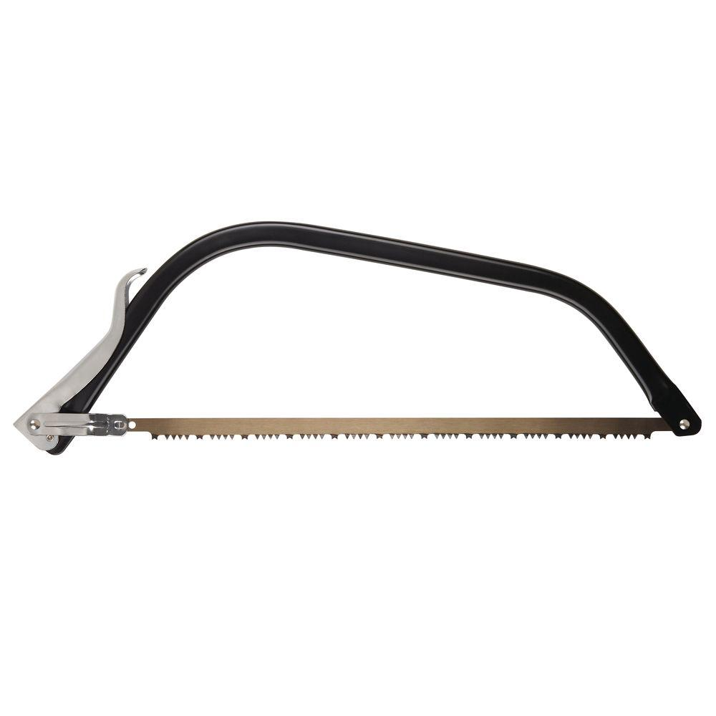
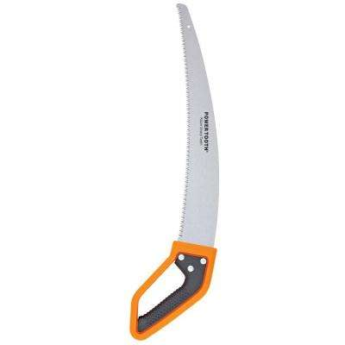
Pruning Tools
Saws: for branches 1 ½ to 5 inches

Slide 20
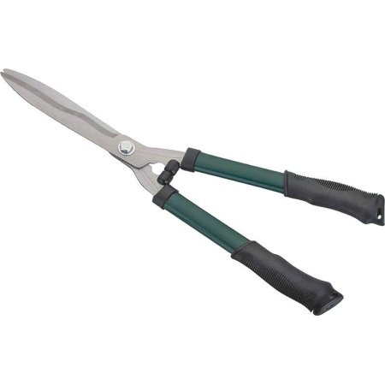
Pruning Tools
Hedge shears: for hedges, small shrubs or deadheading perennials

Slide 21
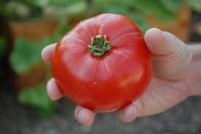
Pruning Tomatoes
Encourages larger fruit production
Allows for better air circulation
Eliminates branches and fruit from the bottom, where they would touch the ground and rot

Slide 22
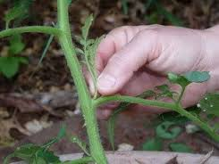
Techniques
Trim off leaves or stems that touch the ground
Remove suckers
Chop off the tops of the plants to 5 or 6’ in height (Labor Day)

Slide 23
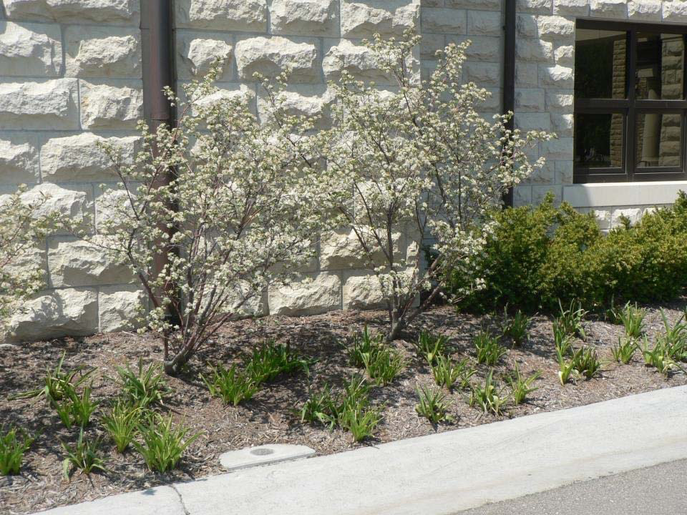
Pruning Shrubs
Pruning Deciduous Shrubs

Slide 24
Rejuvenation pruning
-removal of all canes to a height
of 2-3 inches.
Renewal pruning
-removal of about one-third of the canes to a height of
2-3 inches.

Slide 25
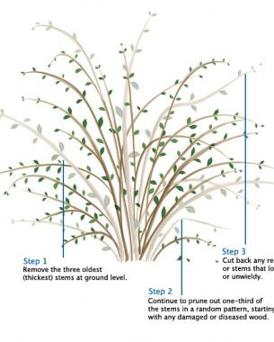

Slide 26
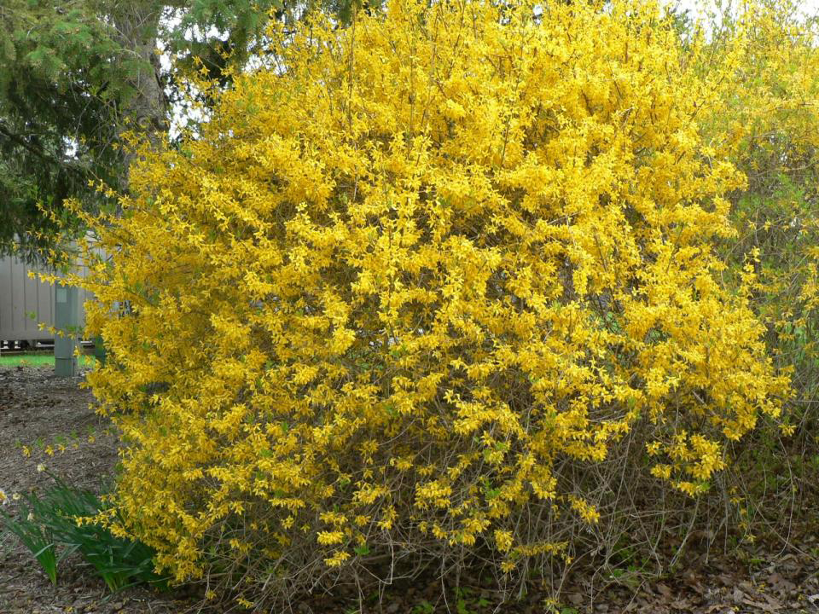
Prune spring flowering shrubs right after they finish blooming:
Bridal wreath spiraea
Forsythia
Lilac
Ninebark
Weigela

Slide 27
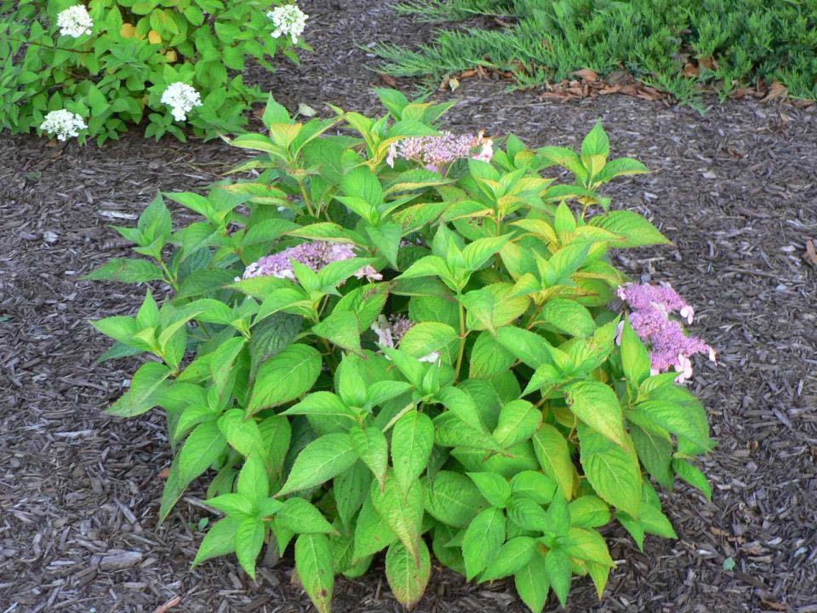
Prune summer and autumn flowering
shrubs during the dormant season as they form their flower buds the same season they bloom:
Hydrangea
Hibiscus

Slide 28
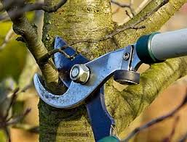
Trimming branches

Slide 29
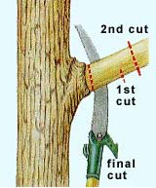

Slide 31
Resources
iGrow(SDSU Extension):
igrow.org/search/?q=pruning+trees
Fine Gardening Magazine:
http://www.finegardening.com/pruning-tips-and-techniques

