Slide 1
Backyard Composting
Cynthia Bergman
Extension Horticulture Educator
Yankton County

Slide 2
What is composting?
Composting is simply speeding up the process of decomposition of organic materials by microorganisms

Slide 3
Compostable Kitchen Bags
easy, odor-free, and clean
made from corn starch and vegetable oils
breakdown 45 days

Slide 4
Why compost?
Landfills are closing to yard waste
Landscape refuse accounts for up to 20% of landfill wastes
Residents could reduce their total annual volume of wastes by 35% if they composted at home.

Slide 5
Why compost?
Knowledge you are making a difference
helping prevent pollution
saving natural resources
curbing climate change
reducing your “environmental footprint”on the Earth

Slide 6
Reasons for Backyard Composting
bans on outdoor burning
practical and convenient way to handle yard refuse
easier and cheaper than bagging

Slide 7
Reasons for Backyard Composting
supplies nutrients and organic matter
buffers soil from chemical imbalances
easier to handle and mix with the soil
free fertilizer

Slide 8
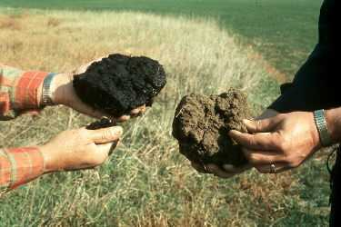
Reasons for Backyard Composting
reduced water use and irrigation costs
compost holds 20X the water of soils low in organic matter

Slide 9
Healthy Soils, Healthy Plants
supports healthy plant growth – protects plants from disease
reduce need for landscape chemicals
prevents erosion
improves soil structure and resists compaction

Slide 10
Decomposition is Important
Adding undecomposed materials directly to the soil without first composting
microbes will compete with plants for soil nitrogen
results in poor plant growth and pest problems

Slide 11
Composting Process
Composting consists of four components
aeration
moisture
temperature
particle size

Slide 12
Composting Process: Aeration
Oxygen is required for some microbes to decompose organic wastes efficiently.
called aerobes
when not enough oxygen is available, aerobes die

Slide 13
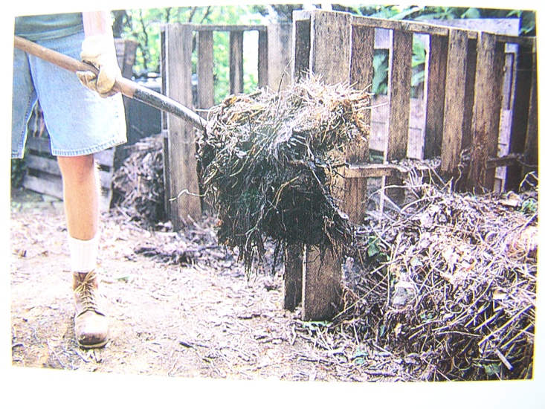
Aeration
Oxygen is required for some microbes to decompose organic wastes efficiently.
called aerobes
when not enough oxygen is available, aerobes die

Slide 14
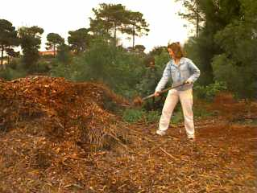
Composting Process: Aeration
Mixing the pile once or twice a month provides the necessary oxygen and significantly hastens the composting process.

Slide 15
Composting Process: Aeration
Some microorganisms decompose organic wastes in the absence of oxygen
called anaerobes
the process is slowed by up to 90%
foul odors may develop
hydrogen sulfide (rotten eggs)
cadaverine
putrescine

Slide 16
Composting Process: Aeration
A pile that is not mixed may take three to four times longer to decompose.
**number one problem in composting
is lack of oxygen**

Slide 17
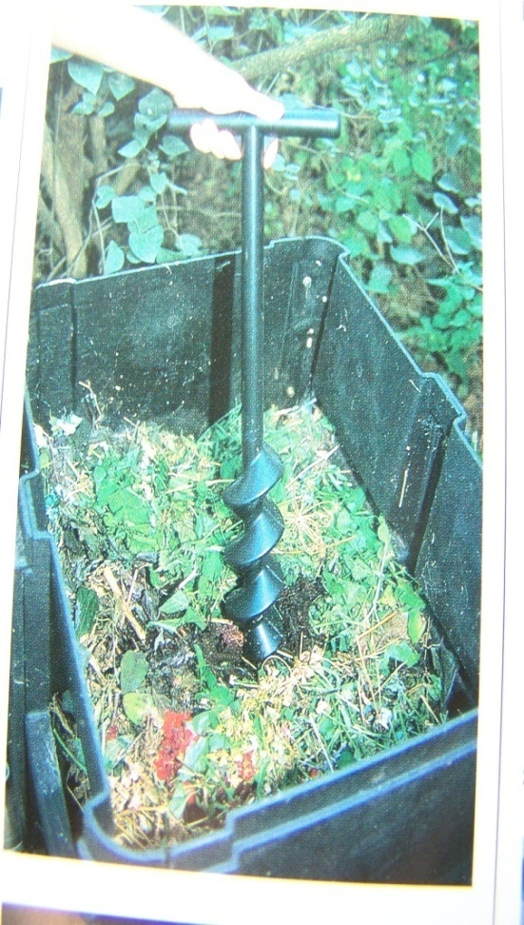
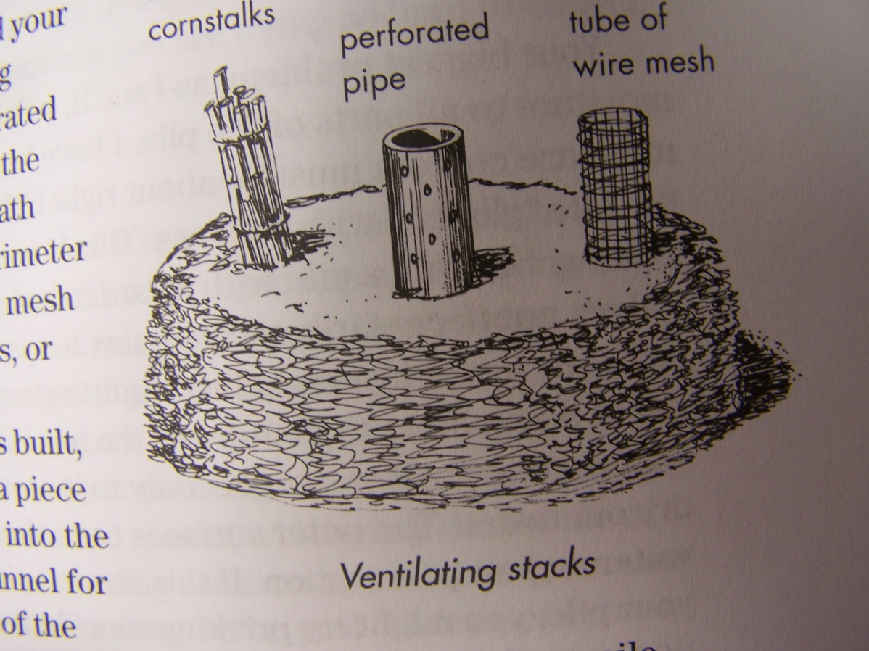
Aeration to reduce odor

Slide 18
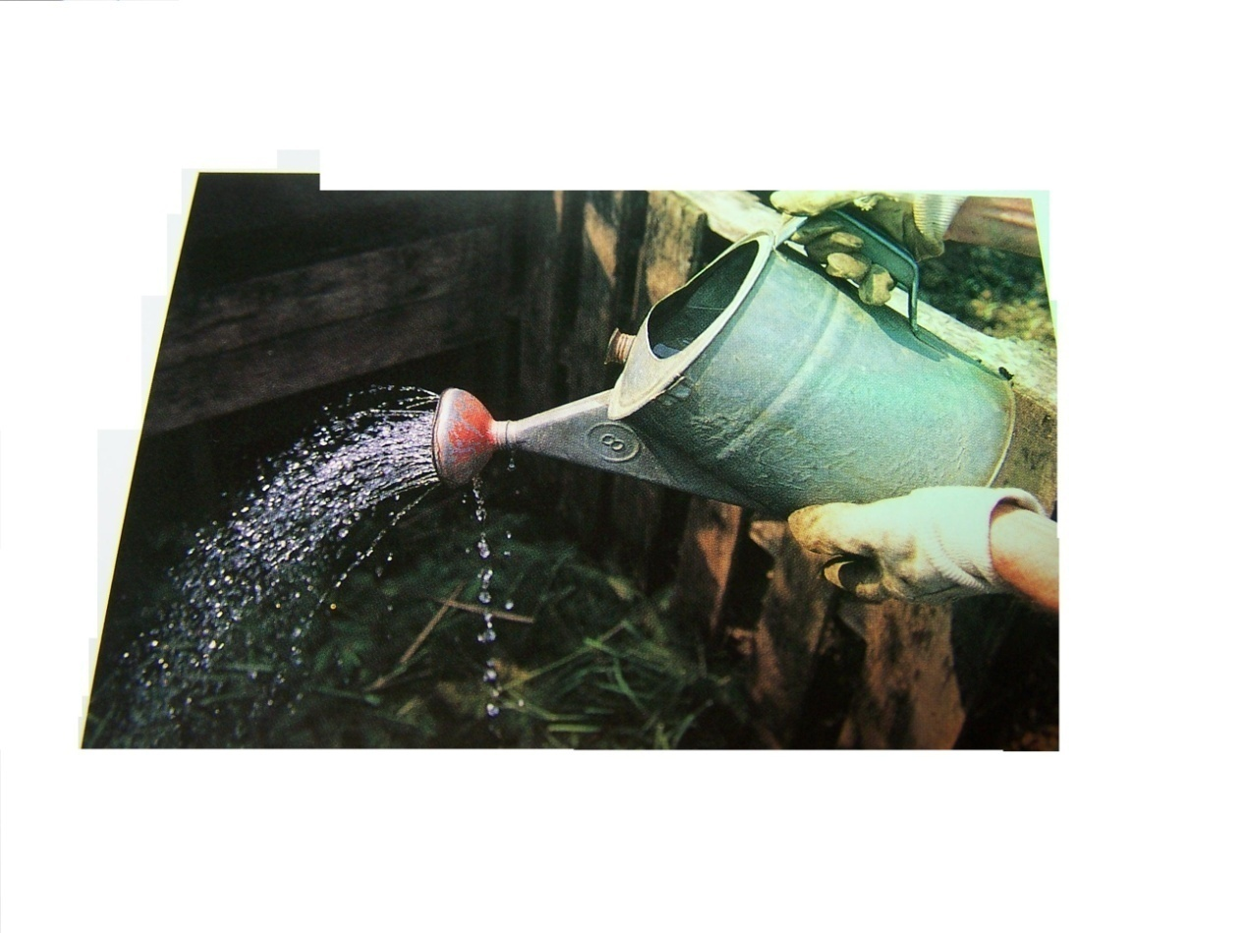
Composting Process: Moisture
proper moisture will feel like a well-wrung sponge
**number two problem in composting
is incorrect moisture**

Slide 19
Composting Process: Moisture
Under 40% is too little moisture
slows decomposition
Over 60% is too much water
forces out the air, leading to anaerobic conditions
slow down the process
causes foul odors

Slide 20
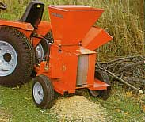
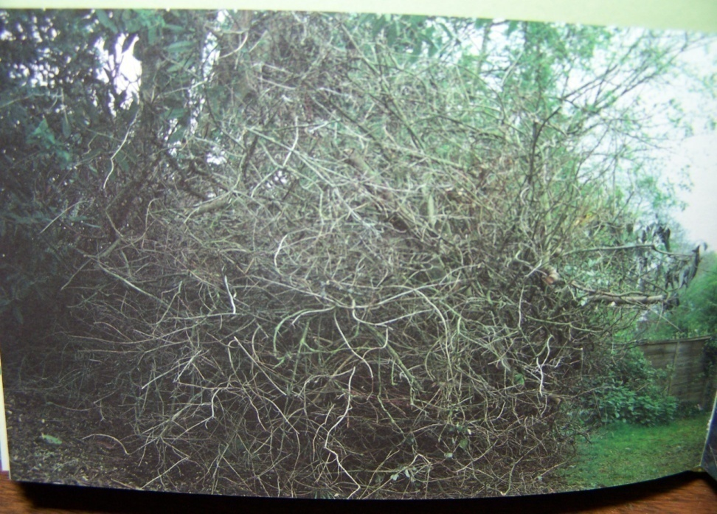
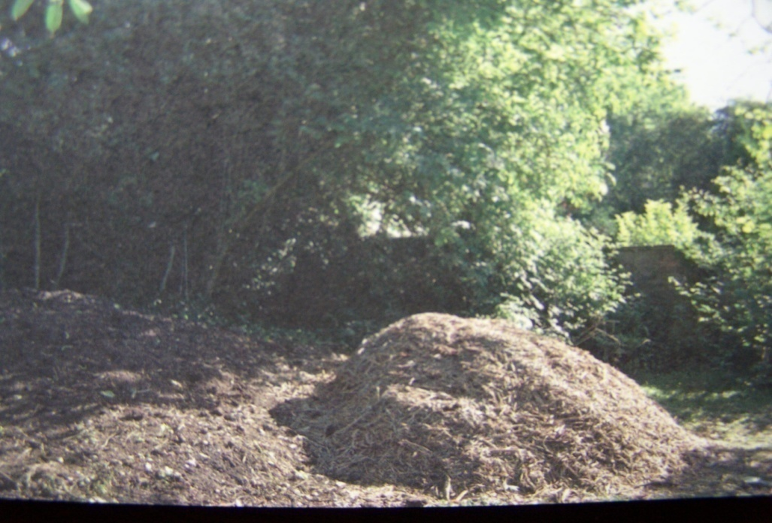
Small Particle Size: wood
The smaller the size of the refuse particle, the more quickly the microbes can consume it.
Grinding the organic material before composting greatly reduces decomposition time.

Slide 21
Composting Process: Particle Size
A low cost method of reducing the size of fallen tree leaves is to mow the lawn before raking.
Windrowing the leaves into long narrow piles one foot high will make the shredding process more efficient.
If the mower has an appropriate bag attachment, the shredded leaves can be collected directly.

Slide 22
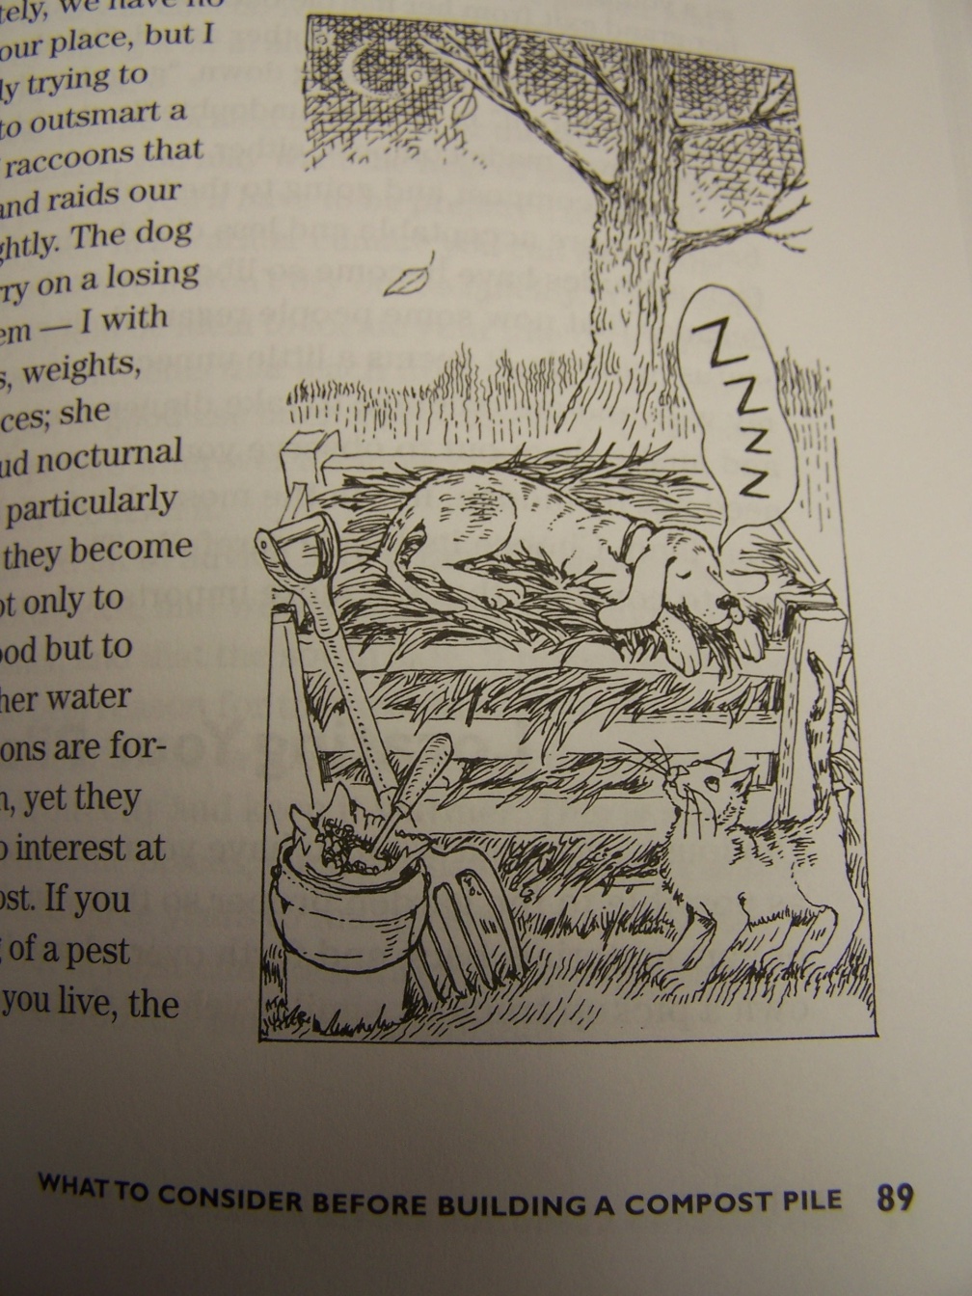
temperature
As they eat, organisms generate a large amount of heat, which raises the temperature of the pile and speeds up decompositon.
On cool mornings, you may see steam rising from the heap.

Slide 23
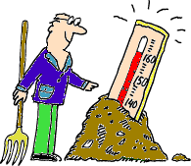
temperature
A minimum pile temperature of 130 to 150°F for at least 3 days is necessary to destroy weed seeds and plant pathogens
(15 days is more effective)

Slide 24
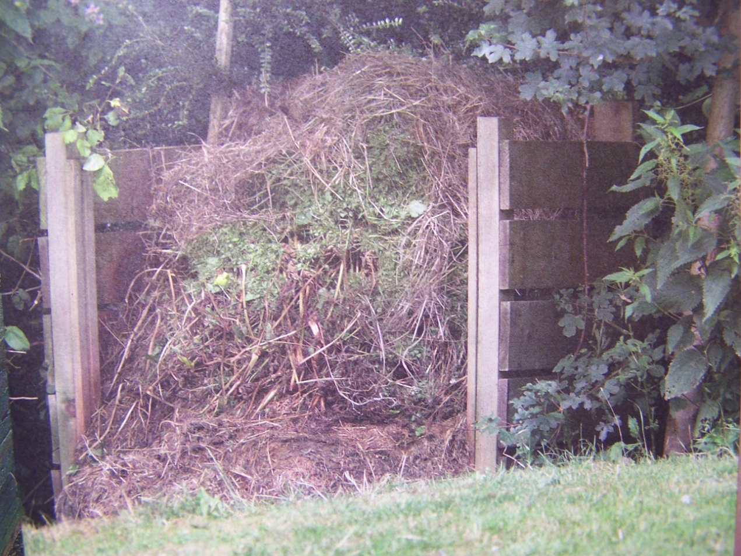
temperature
Very few homeowners can create a “hot” pile, with temperatures high enough to kill pathogens and weed seeds.

Slide 25
Composting Process: Temperature
If the pile does not heat up, the cause may be one or more of the following:
too small a pile
not enough nitrogen
lack of oxygen
too much moisture
not enough moisture

Slide 26
Materials NOT for Composting
adding lime to pile will convert nitrogen to ammonia and hasten the loss of nitrogen from the pile
lime may hasten decomposition, but not worth the loss of nitrogen
South Dakota soils already alkaline, no need to add calcium, dolomite, or lime

Slide 27
Materials NOT for Composting
Meat scraps
Fats, oils, grease
Pet and/or human feces
Diseased plants
Weeds when seed head present

Slide 28
Materials NOT for Composting
Walnuts and walnut leaves
allelopathic (toxic to some plants)
use small amounts
Treated grass clippings
most lawns treated for dandelions
many lawns treated for insect control

Slide 29
Materials NOT for Composting
Ash from your charcoal grill
excessive levels of sulfur and iron, enough to be toxic to your plants
coal decays so slowly it is found in archaeology digs
Large chunks of anything
corn sheafs, brush, or wood chips

Slide 30
Compost Materials
You can burn the peels of fruits to create ash, which releases the potassium quicker
Wood ash not only breaks down into potash, it is also a pest deterrent.
unfortunately, it will also leach out the nitrogen from manure
add to manure later

Slide 31
Suitable Compost Materials
“browns”
“greens”
dried leaves
twigs
newspapers
Straw
Sawdust
grass clippings
kitchen food scraps
yard trimmings
green plant debris

Slide 32
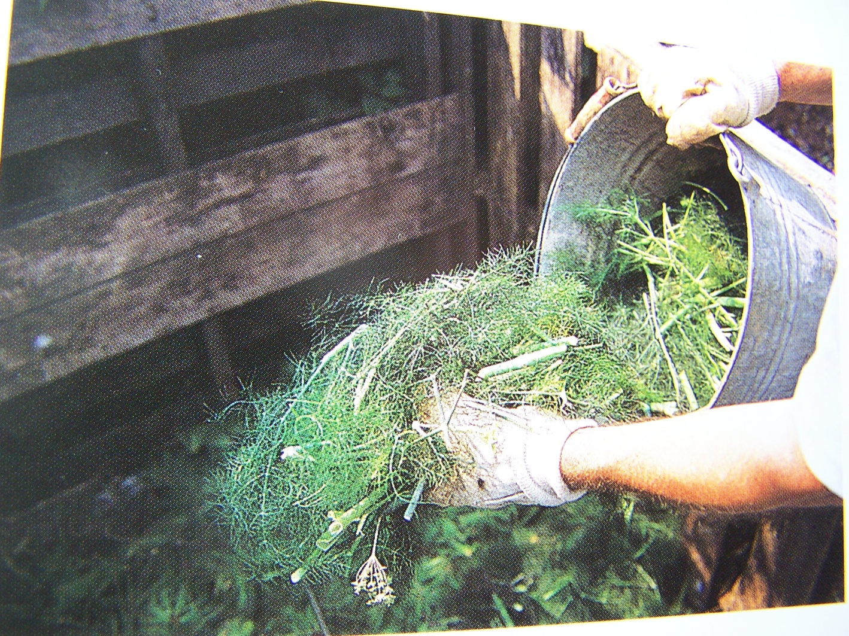
Suitable Compost Materials

Slide 33
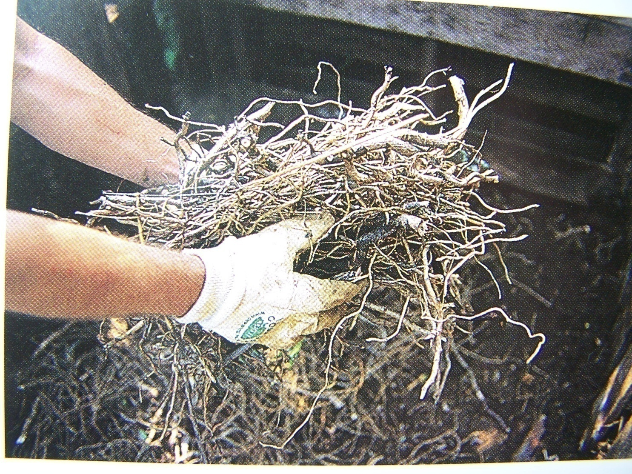
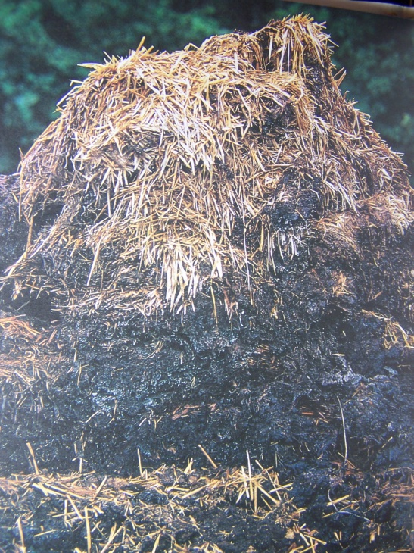
Suitable Compost Materials

Slide 34
Starting the Compost Pile
coarser materials decompose faster in the bottom layer.
allows air circulation around the base of the pile creating a chimney effect that will take air up through the pile and heat it up

Slide 35
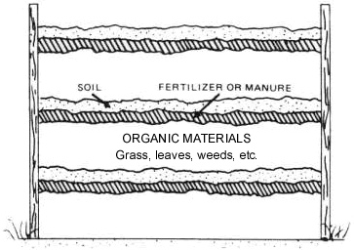
Starting the Compost Pile
Bottom coarse matterial.
Then layer each of organic waste, soil and fertilizer.
Repeat until the pile is completed.

Slide 36
Starting the Compost Pile
Pile up to about five feet high
Moisten all layers as they are put in the pile - watered until moist, but not soggy.
Finish pile off with six inches of straw or hay, with a scooped out basin on top to catch rainwater.

Slide 37
using browns & greens

Slide 38
Equipment
Needed
Not needed
Gloves
Pitchfork
Hose or watering cans
Pruning shears
Flat shovel (not spade)
Wheelbarrow
Aerators
Saws, lopping shears, and hedge clippers
Screens

Slide 39
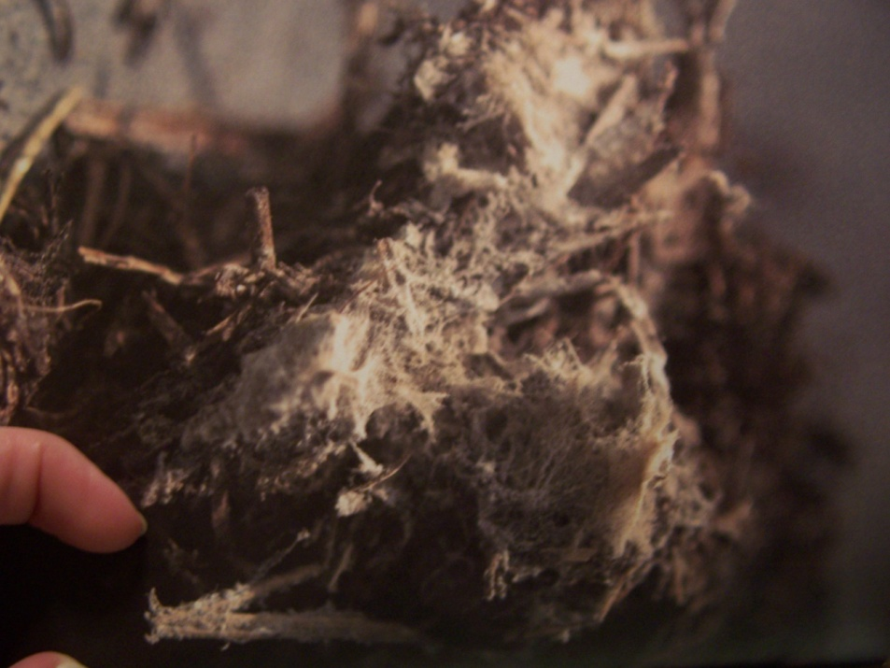
Free workers do decomposition
Major players are mircroorganisms
bacteria
fungus
actinomycetes
the pleasant, earthy smell comes from actinomycetes

Slide 40
Free workers do decomposition
Macroorganisms help
worms
pillbugs (also called sowbeetles)
centipedes
other insects running around and in the piles
nematodes

Slide 41
Composting Structures

Slide 42
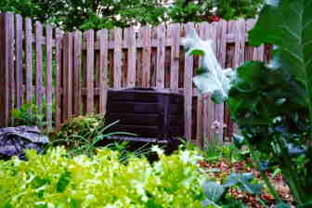
Composting Structures
contain the pile
save space
hasten decomposition
keep the yard looking neat
can consist of a variety of materials
can be as simple or complex as desired.

Slide 43
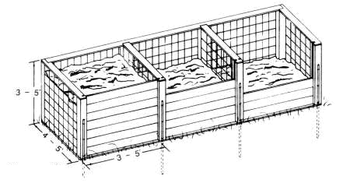
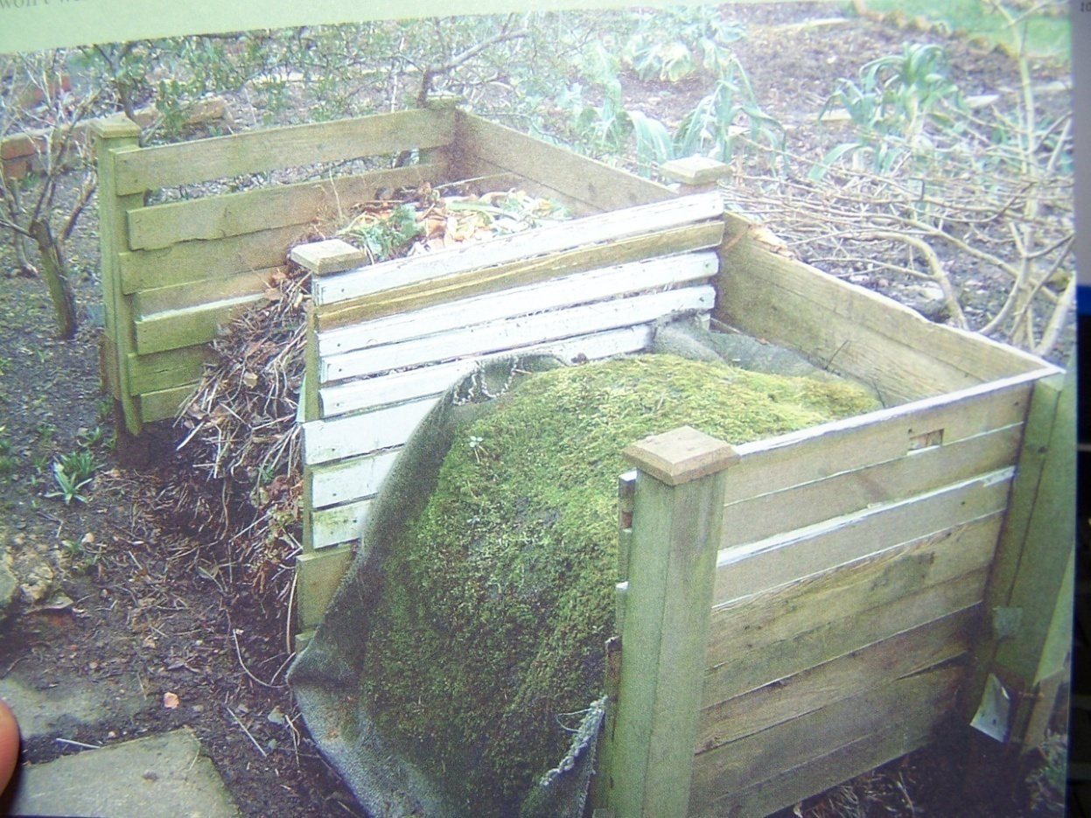

Slide 44
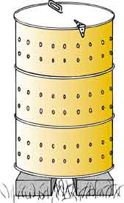
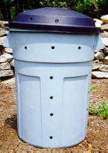
Any metal or plastic barrow or drum can be drilled with holes to increase aeration.

Slide 45
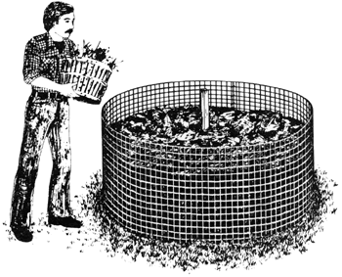
Georgia’s Guide to Managing Organic Landscape Refuse Horticulture 1 Circular 816 Reprinted June 1999
Photo by Wayne J. McLaurin and Gary L. Wade Extension Horticulturists in Georgia

Slide 46
Figure 2
Chicken wire or other finer weaves of wire make cheap, easy to make, portable areas to hold the compost “pile”.

Slide 47
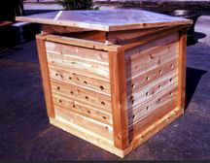
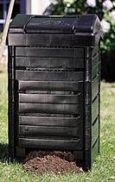
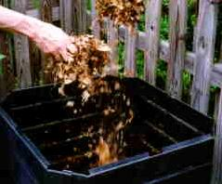
Compost Bin Structures

Slide 48
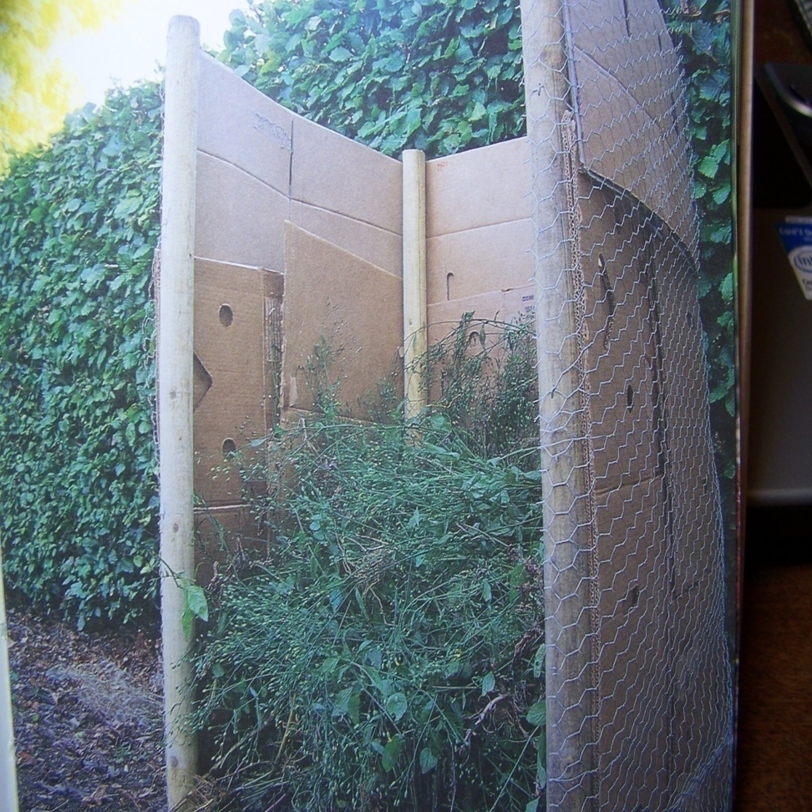
other structures
no one structure is best. Most are for the city dweller wanting an easy way to make small amounts quickly
Invent your own, or consult one of the several new books on composting.

Slide 49
Location of compost piles
close to where it will be used - near the garden or kitchen
where it will not interfere with activities in the yard
where the sight and smell will not offend neighbors
in partial sunlight help (to heat the pile)

Slide 50
where NOT to put compost piles
the more wind and sun to which the pile is exposed, the more water it will need
do NOT place piles against any buildings – the moisture may cause problems.

Slide 51
where NOT to put compost piles
sloped areas may cause the pile/bin to tip over
don’t place on non-porous surface – this inhibits decomposition
Stay at least 3 feet away from large trees – the excess nitrogen runoff may affect them

Slide 52
Maintaining the Compost Pile

Slide 53
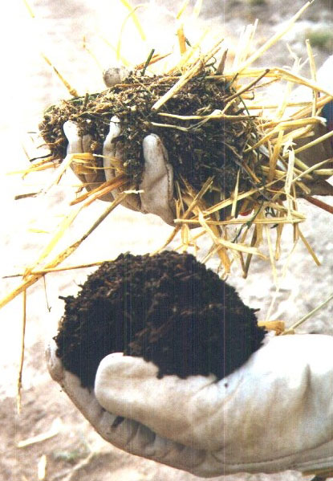
Maintaining the Compost Pile
If the pile does not heat up, the cause may be one or more of the following:
too small a pile
not enough nitrogen
lack of oxygen,
too much moisture
not enough moisture

Slide 54
Troubleshooting guide to composting problems.
Symptoms / Problems
The heap is damp and sweet smelling but still will not heat up.
Solutions
Lack of nitrogen. Mix in a nitrogen source like fresh grass clippings, fresh manure, or bloodmeal.

Slide 55
Troubleshooting guide to composting problems.
Symptoms / Problems
The compost is damp and warm only in the middle.
Solutions
Too small. Collect more material and mix the old ingredients into a new pile.

Slide 56
Troubleshooting guide to composting problems.
Symptom / Problem
The compost has a bad odor.
Solution
Not enough air. Turn it.
Add browns (dry material) if the pile is too wet.
Minimize odor by covering pile with layer of dirt or finished compost.

Slide 57
Troubleshooting guide to composting problems.
Symptoms / Problems
The center of the pile is dry.
Solutions
Not enough water. Moisten and turn the pile.

Slide 58
Troubleshooting guide to composting problems.
Symptoms / Problems
Pile never finishes.
Solutions
Continuously adding materials will keep starting the process over each time.
Start a second pile and allow the first pile to finish.

Slide 59
Cynthia Bergman
Extension Horticulture Educator
Yankton County
901 Whiting Drive
Yankton, SD 57078
Phone (605) 665-3387
cynthia.bergman@sdstate.edu
Yanktonhorticulture.webs.com

