Slide 2
Presented by Missouri Valley Master Gardeners

Slide 3
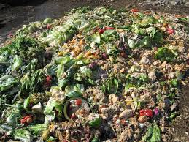
Good, Better and Best Compost Piles
By Dean Spader

Slide 4
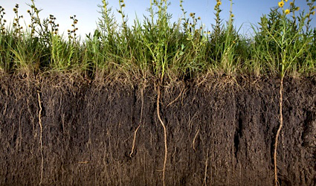
Soil is Alive
Like our lungs, soil needs air-compost increases aeration
Like our bodies, soil needs nutrients-compost slowly releases nutrients
Healthy soil provides immunity
Compost adds balance pH

Slide 5
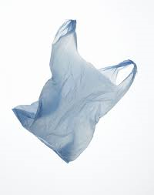
Good for Earth
Lessens the use of fossil fuel, it takes 30,000 cubic feet of natural gas to create a ton of nitrogen
Recycles kitchen waste, grass clippings, leaves and potting soil. This eliminates use of plastic bags
Stops the depletion of diminishing supply of peat
Eliminates unnecessary tilling
Compost holds 20 time as much water

Slide 6
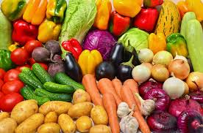
Goals in Composting
To obtain rich stable humus
To harvest nutritious produce
To use sustainable resources

Slide 7
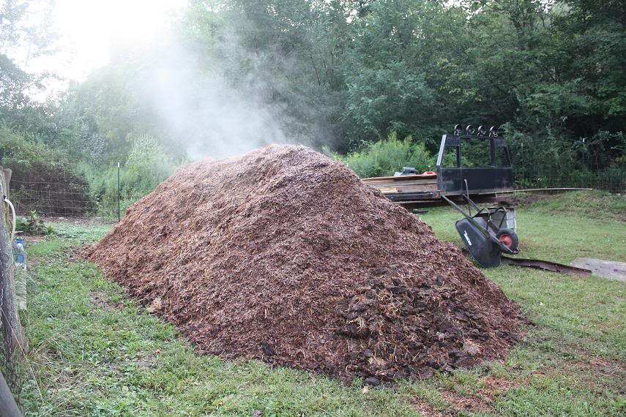
Types of Composting
Area composting
Trench composting
Pile Composting
Cold
Hot

Slide 8
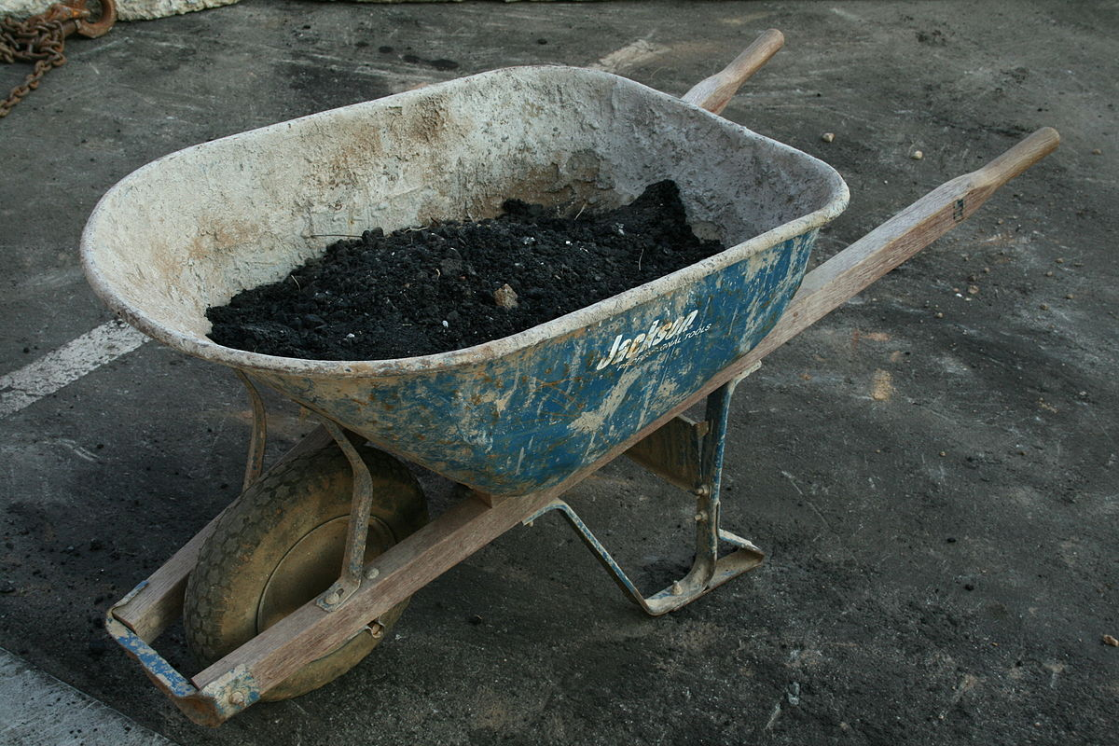
Tools Needed
Gloves
Pitchfork
Hose or watering cans
Pruning shears
Flat shovel (not spade)
Wheelbarrow

Slide 9
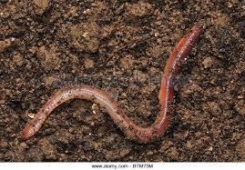
Living Tools-Decomposers
Don’t use any “cides” herbicides, pesticides, fungicides
Be aware that manure may contain herbicides. When herbicides are used on pastures and grasslands they may become concentrated as they pass through animals.
Millipedes, centipedes, sow bugs, snails, slugs, spiders, springtails, beetles, ants, flies, nematodes all add to composting
Earthworms what comes out is 10 more fertile than what goes in

Slide 10
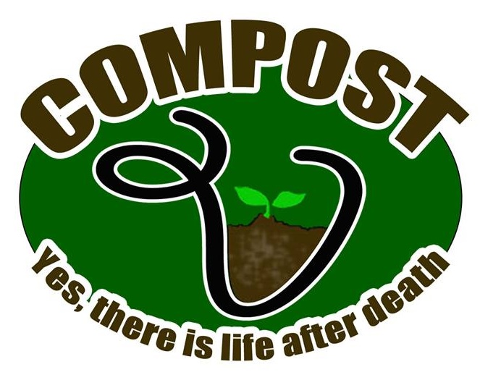
Composting is like brewing wine
Carbon comes from carbohydrates and nitrogen from proteins
Best 12-1 carbon-nitrogen ratio
Better 25-1
Good above 25-1, this will take the longest to break down

Slide 11
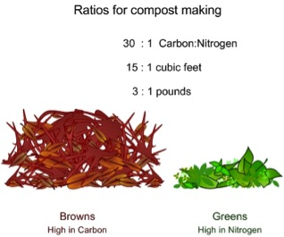
Carbon and Nitrogen
All plant material contains a mixture of carbon and nitrogen
All plants have more carbon than nitrogen
The higher the carbon content the longer it will take to meet the 12-1 ratio

Slide 12
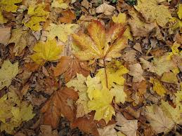
Brown Materials
Dry brown-high carbon materials
Coffee grounds 20:1
Leaves 60:1
Newspaper 50-200:1
Rotted manure 20:1
Sawdust 400:1

Slide 13
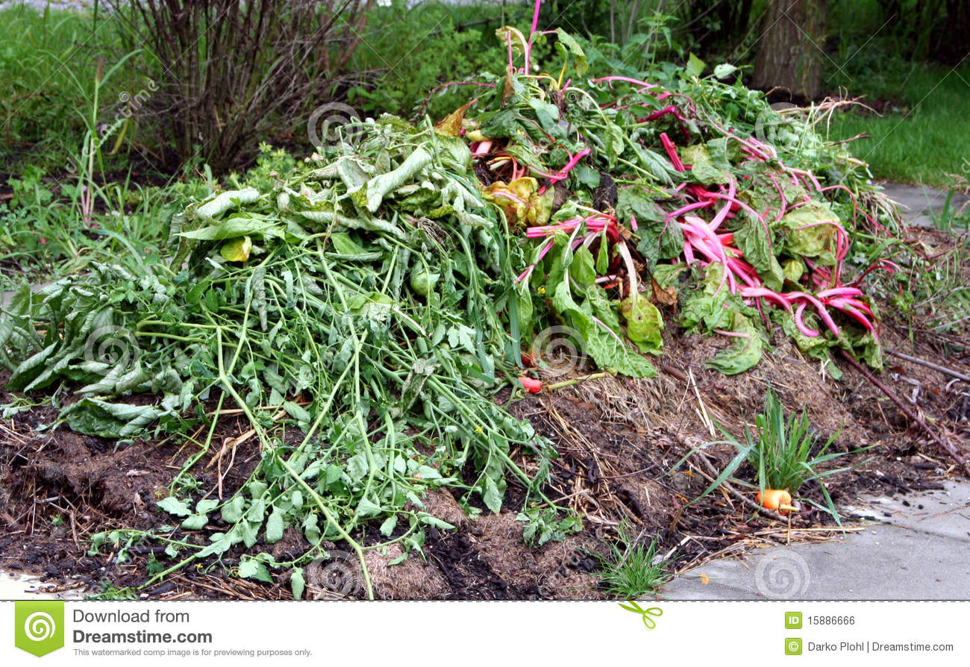
Green Material
Grass clippings 20:1
Table scrapes 15:1
Vegetable trimmings 12-20:1
Yard trimming

Slide 14
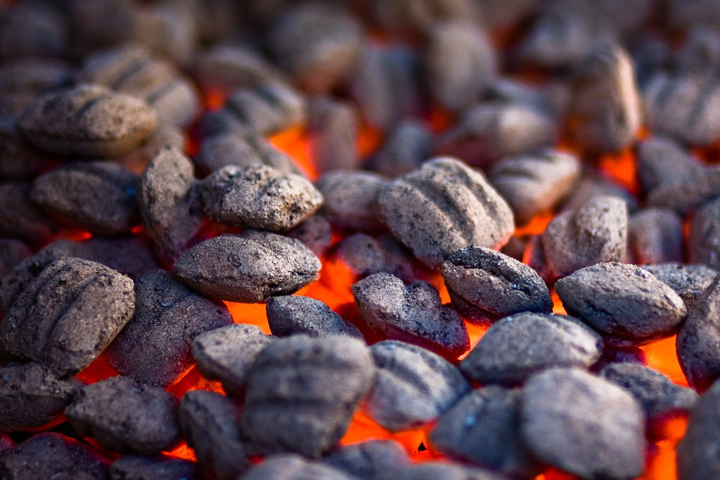
Do NOT Add
Meat scrapes
Fats, oils, grease
Pet or human feces
Diseased plants
Ash from charcoal grill, excess levels of sulfur and iron that could kill plants

Slide 15
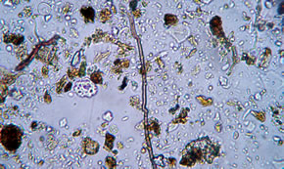
Composting Process Components
Aeration-some microbes require to decompose organic material
Moisture-less than 40% moisture slows down over 60% reduces available O
Temperature-ideal 125 to 135 degrees
Particle size-smaller the size the easer for microbes to decompose

Slide 16
Building Your Compost Pile
About 8 inches of brown material-for carbon and oxygen
About an inch of soil or compost to provide bacterial composters
Third layer of manure or wet green items such as grass clippings or green vegitation
Repeat
Top with thin layer of soil
Water until brown material is damp

Slide 18
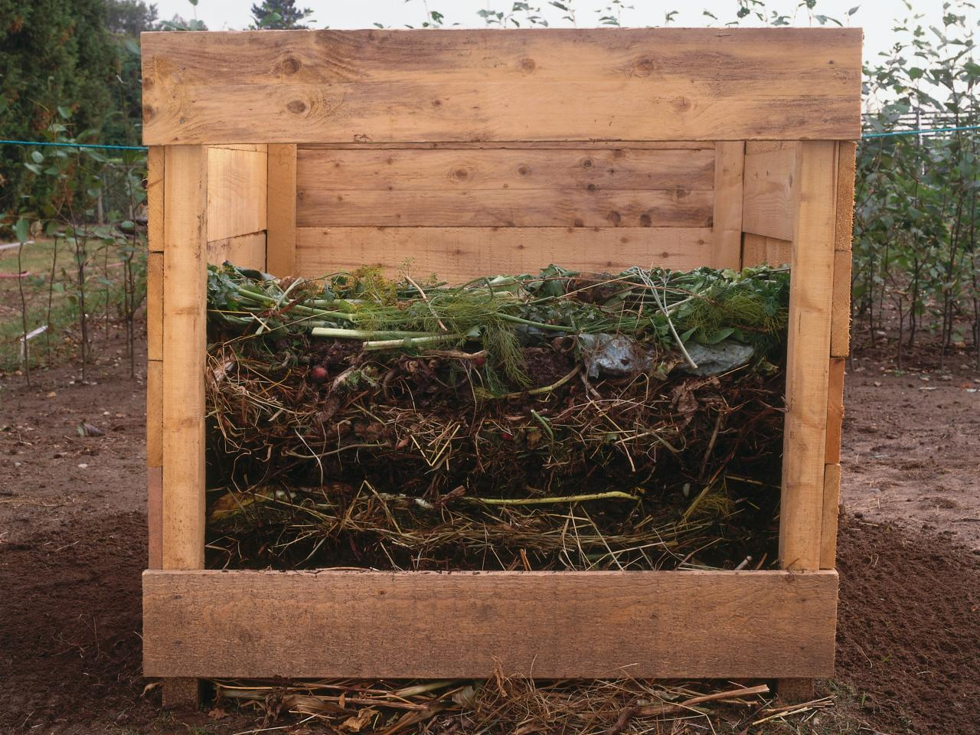
Size
Less than 3 X 3 X 3 will be too small to heat up, can be used for cold composting that takes more time
Over 5 X 5 X 5 will be too large to get necessary oxygen
4 X 4 X 4 ideal
and should be
turned 2 or 3 times

Slide 19
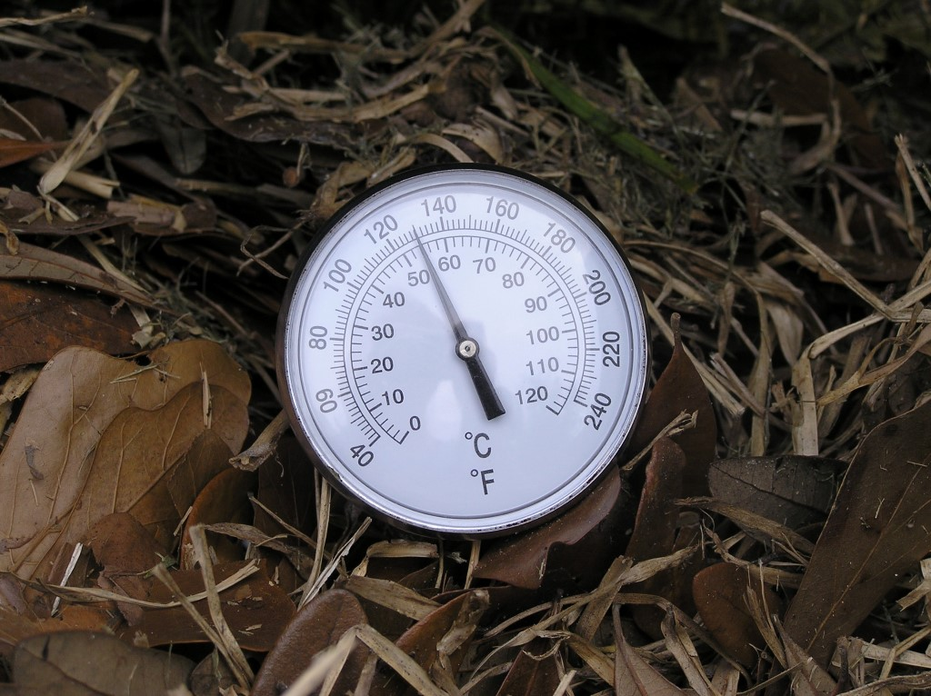
Monitor
The pile should heat up within a couple days
125-135 the best temperature to maintain
The center of the pile should start to sag and dry out with a decrease in the temperature within a couple weeks
First turn within five weeks
Move sides of pile to center
Add water
Keep high

Slide 20
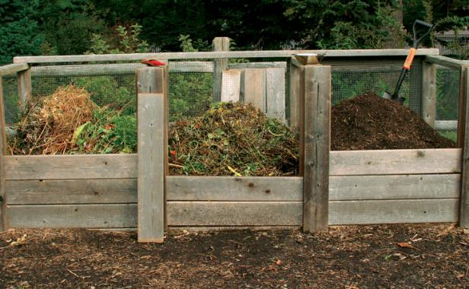
Comments
South Dakota soil is alkaline, do not need to add lime, gypsum, bone meal that are need for acid soil
Place in partial sun not shade
Do not place against buildings

Slide 21
