Slide 1
Vegetable Garden Pests
(Tomatoes, peppers, green beans, cucumbers. & squash)
By Diana Klassy South Dakota Master Gardener

Slide 2
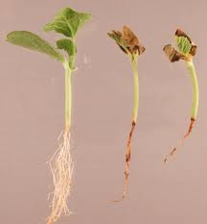
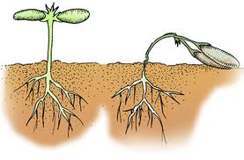
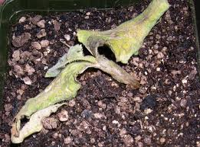
Damping-Off
Caused by fungi living in or near the surface of the soil
Providing good air circulation for seedlings is helpful

Slide 3
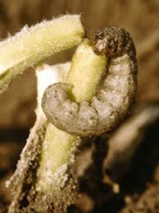
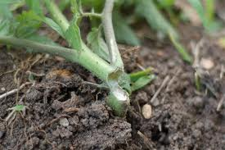
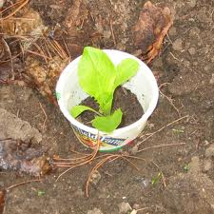
Cut worms
Protect transplants with stiff paper collars around the stems burying it at least 1 inch deep in the ground

Slide 4
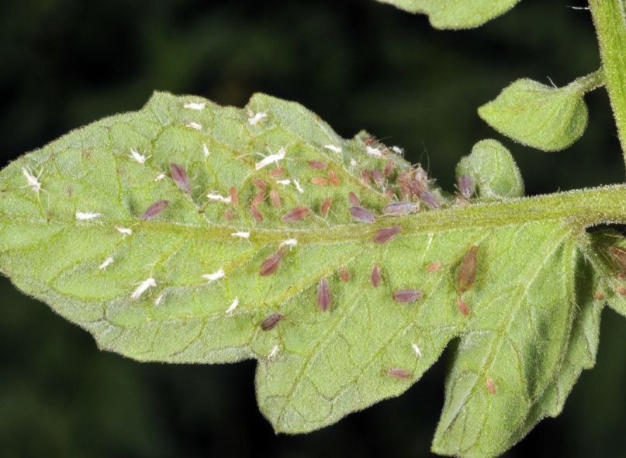
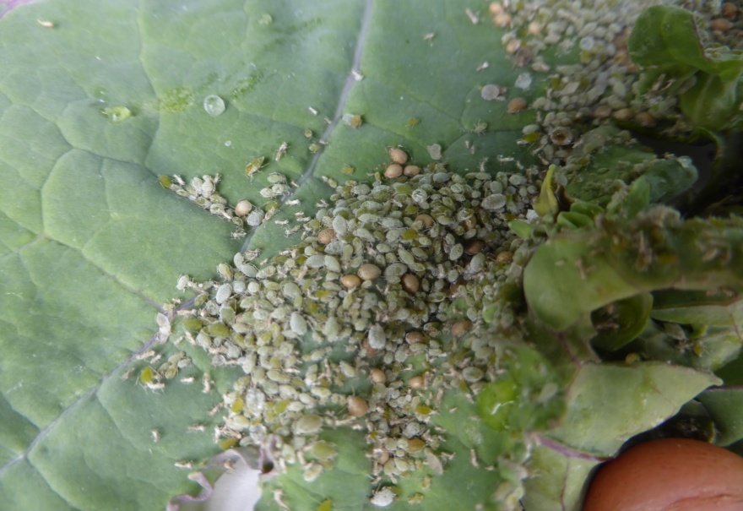
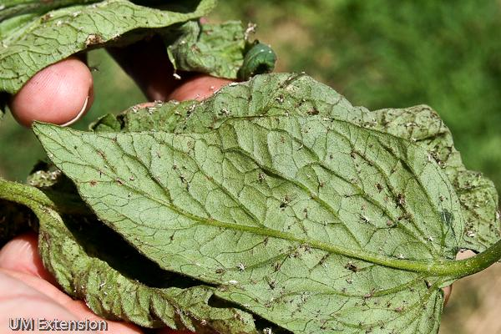
Aphids
Can be controlled by blasting with strong stream of water

Slide 5
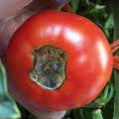
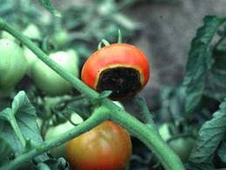
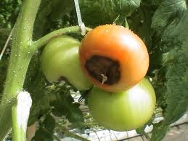
Blossom-end Rot
A deficiency of calcium is the basic cause of the trouble
Consistent watering is important

Slide 6
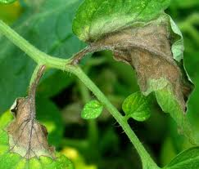
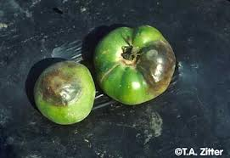
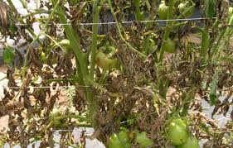
Late Blight on Tomato

Slide 7
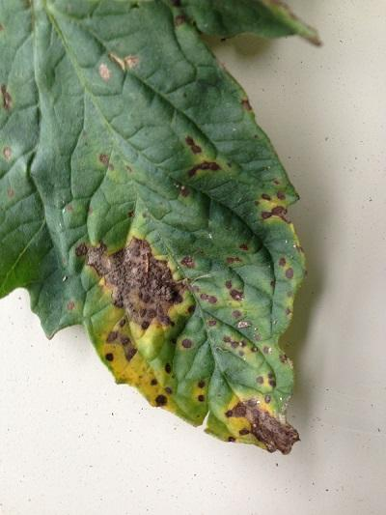
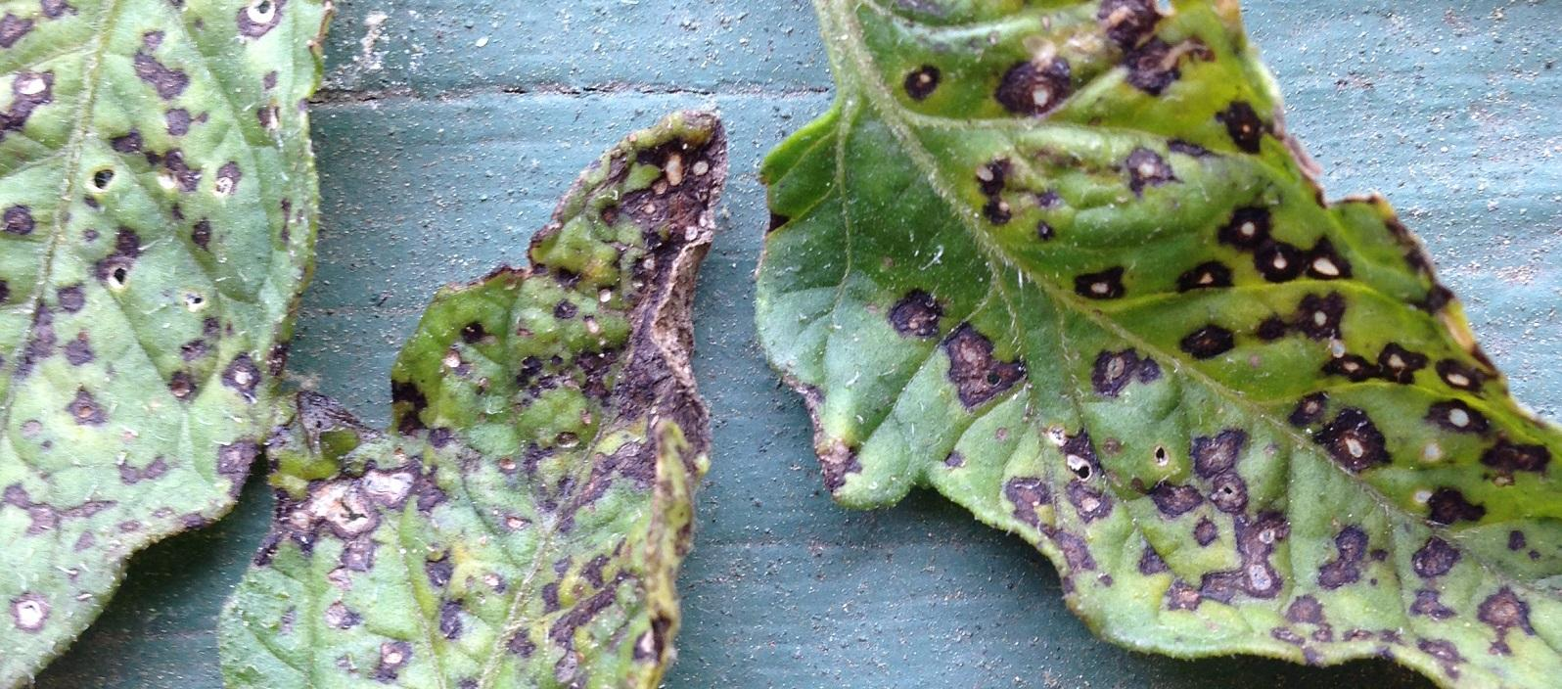
Septoria leaf spot on tomato

Slide 8
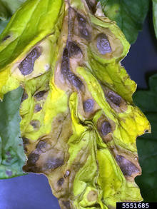
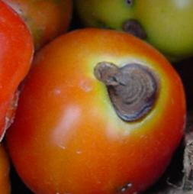
Early blight on tomato

Slide 9
Preventing Tomato Diseases
Grow resistant varieties
Crop rotation
Water soil, not leaves
Provides good air circulation
Don’t compost diseased leaves & plants

Slide 10
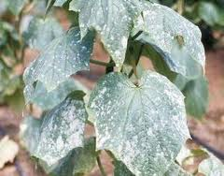
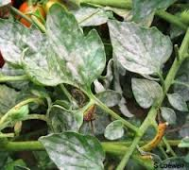
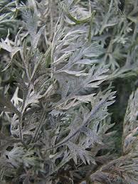
Powdery Mildew

Slide 11
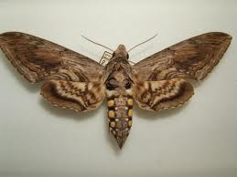
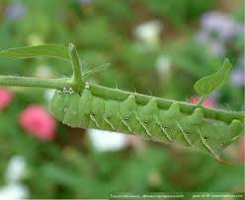
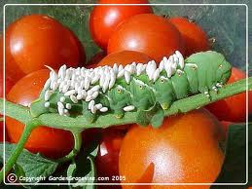
Tomato Hornworm
Hand pick and destroy unless you see the egg cases of this parasitic wasp

Slide 12
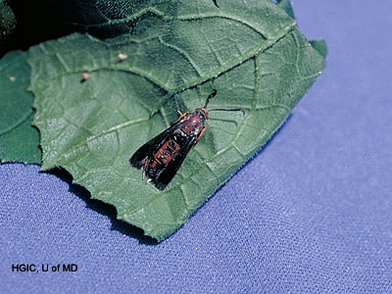
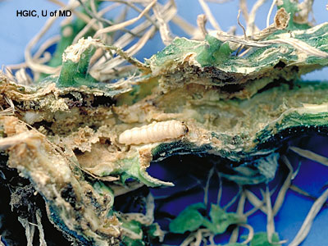
Squash Borer s

Slide 13
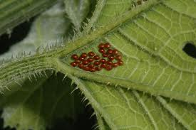
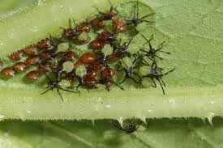
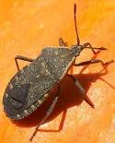
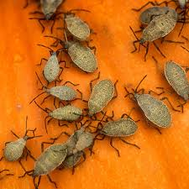
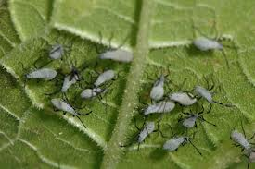
Squash Bug (stink bug)

Slide 14
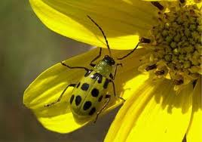
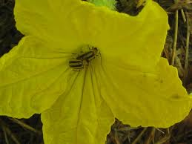
Cucumber Beetle
These beetles also carry diseases

Slide 15
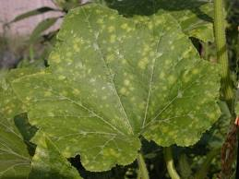
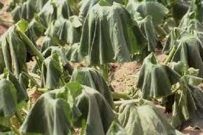
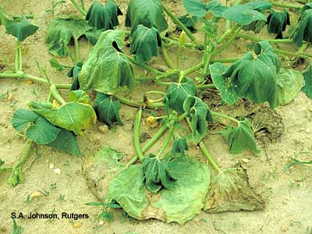
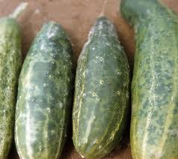
Cucumber Mosaic Virus & Bacterial Wilt

Slide 16
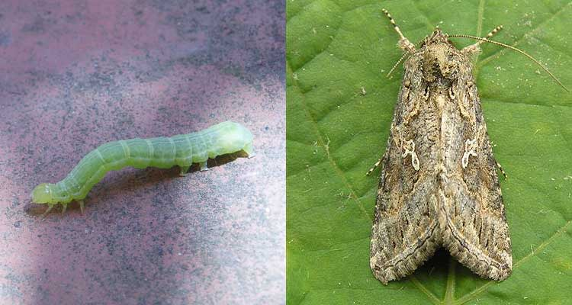
Cabbage “Worms”
Net catch the white moths & hand pick the caterpillars
OR…

Slide 17
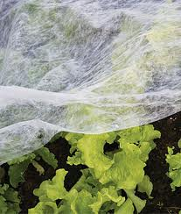
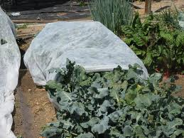
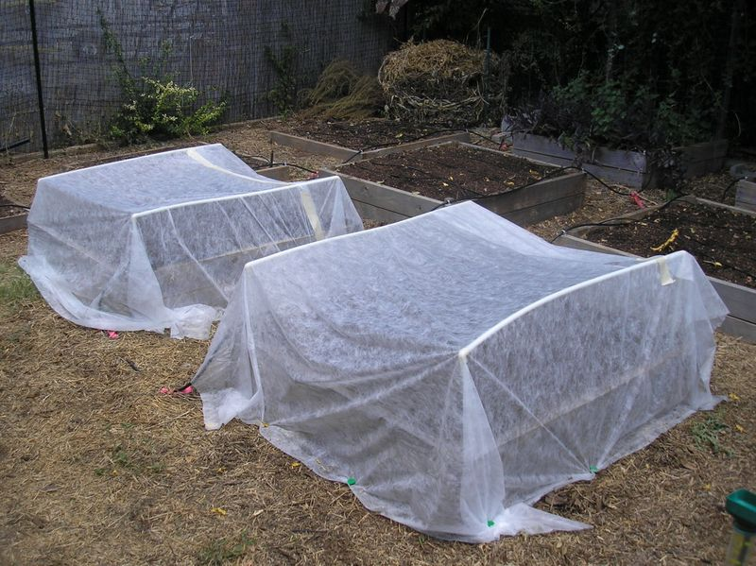
Floating Row Covers
Must be removed off flowering vegetables for in time for pollinators

Slide 18
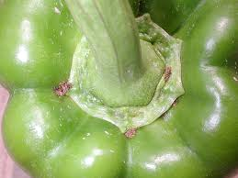
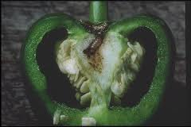
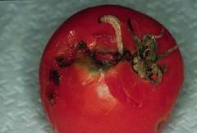
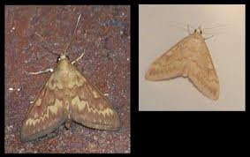
European Corn Borer

Slide 19
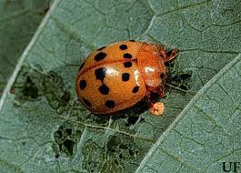
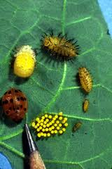
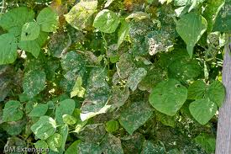
Mexican Bean Beetle
Hand pick and squish or drop into soapy water to drown

Slide 20
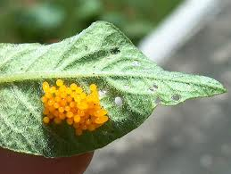
Colorado Potato Beetle
Hand pick and squish or drop into soapy water to drown

Slide 21
Spider Mites on Green Beans

Slide 22
Controlling Spider Mites
Confirm the pest with the white paper test
Spray underside of leaves with strong water spray
Repeat every three days for about a week (3 times)
Repeat white paper test
Don’t delay treatment as mites can defoliate the plants in just a very few days!

Slide 23
References:
University of Maryland Master Gardener Handbook
Encyclopedia of Organic Gardening by Rodale Press
Maryland Cooperative Extension Home & Garden Publications
SDSU Extension Master Gardener Manual

